Slide 1
Steroids kill!
What other options are there?
David Rowbotham
Consultant Gastroenterologist, ADHB

Slide 2
Disclaimer
“This is a presentation at a meeting sponsored by Janssen Pharmaceuticals.
The views and opinions expressed in the following presentation are those of the presenter and do not necessarily reflect those of Janssen Ltd.
Janssen Ltd does not endorse the use of unregistered products or products outside of their registered indications.
Please refer to Product Information or Data Sheets for licensed instructions.”

Slide 3
Disclosures
Advisory Board
Janssen; Abbvie; Baxter; Pharmaco; Hospira
Speaker fees
Janssen; Abbvie; Baxter; Pharmaco; bioCSL;
Given imaging; Emerge Health

Slide 4
Declaration
In the spirit of honesty and fairness, I feel it only proper that I declare openly at the start … (in case you were in any doubt) …
I hate steroids with a passion
It’s the easy way out
Even my colleagues overuse them …

Slide 5

Case
28 year old beautician and model
Many years of gut symptoms:
  bloating, pain, variable diarrhoea
Always told it was just IBS
Dr Gastroenterologist …

Slide 6
Finally had colonoscopy and diagnosed with Crohn’s disease
“Treated” with steroids, which made her feel so much better
Symptoms relapsed on steroid withdrawal
Further course steroids helped again
etc.
etc.
etc.

Slide 7
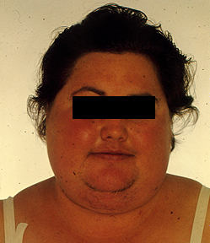
Until …

Slide 8
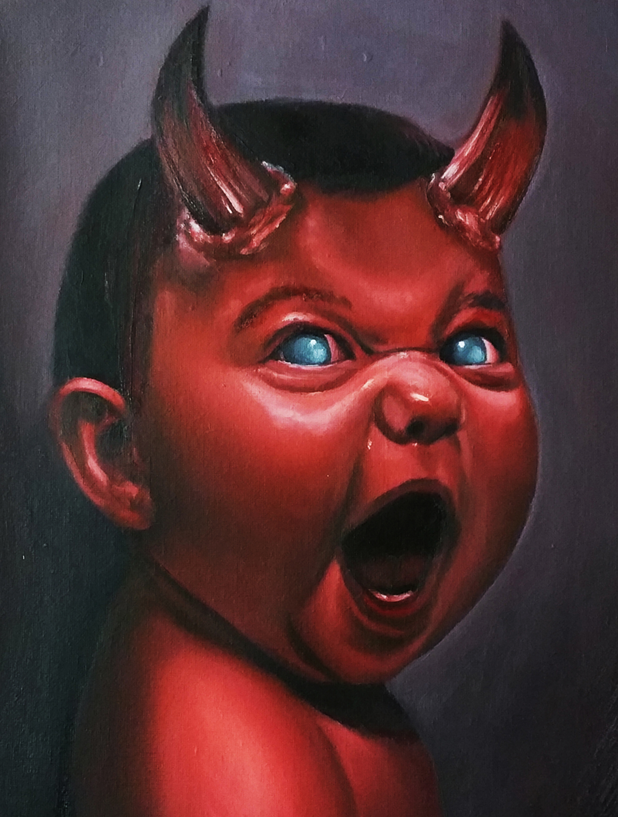
Steroids: “Only a short course” …
GP
GP Locum
Private A&E
Hospital ED House Officer
Surgical Registrar
IBD Nurse
Consultant (not me)
Patient themselves (old stock)

Slide 9
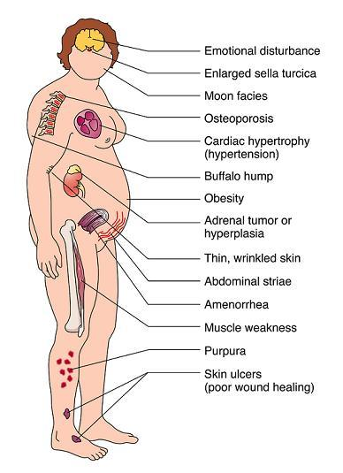
Pretty soon …
Acne
Fat
Striae
Cushing’s
Diabetes mellitus
Hypertension
Psychosis
Proximal myopathy
#’s
F**ked!

Slide 10
Budesonide
90% first pass hepatic metabolism
So less of the usual steroid side effects

Slide 11
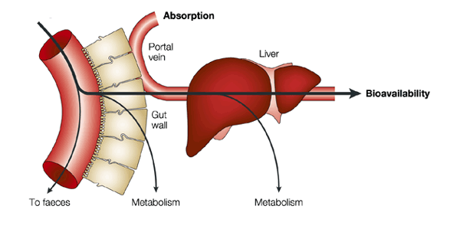
Budesonide
OF COURSE there’s less of the steroid side effects …
It’s all been metabolised on its way through the liver!

Slide 12
Budesonide
Despite the fact that it doesn’t really work, even Budesonide eventually leads to …

Slide 13
But it’s not just aesthetics …

Slide 14
Evidence
Five-year Safety Data From ENCORE, a European Observational Safety Registry for Adults With Crohn’s Disease Treated With Infliximab [Remicade®] or Conventional Therapy
D’Haens G et al., Journal of Crohn's and Colitis, 2017, 680–689 doi:10.1093/ecco-jcc/jjw221
Prednisone use was associated with higher mortality [HR = 3.58, CI: 1.49, 8.61]
Risk factors of increased mortality [HR; 95% CI] were patient age [1.08; 1.06, 1.10; p < 0.0001], presence of draining fistula within 4 weeks preceding baseline [2.45; 1.23, 4.87; p = 0.011], and use of prednisone [3.58; 1.49, 8.61; p = 0.004]
Use of IFX was associated with decreased mortality (similar to adalimumab; Colombel JF et al. Adalimumab safety in global clinical trials of patients with Crohn’s disease. Inflamm Bowel Dis 2009;15:1308–19)

Slide 15
Evidence
Serious Infection and Mortality in Patients With Crohn ’ s Disease: More Than 5 Years of Follow-Up in the TREAT ™Registry
Lichtenstein GR et al. Am J Gastroenterol 2012; 107:1409–1422. doi: 10.1038/ajg.2012.218
Investigating medication use among patients who died relative to those who did not, neither IFX not IMM treatment was a significant predictor of death
Treatment with prednisone (HR = 2.14, 95 % CI = 1.55, 2.95; P < 0.001) or narcotic analgesics (HR = 1.79, 95 % CI = 1.29, 2.48; P < 0.001) both significantly predicted death ( Table 5 ).

Slide 16
TREAT Table 5

Slide 17
TREAT Table 5

Slide 18
Evidence (pandemic)
Corticosteroids, But Not TNF Antagonists, Are Associated With Adverse COVID-19 Outcomes in Patients With Inflammatory Bowel Diseases: Results From an International Registry
Brenner EJ et al., Gastroenterology 2020;159:481–491 doi.org/10.1053/j.gastro.2020.05.032
SECURE-IBD Cohort (Total N = 525)
`Treatment with prednisone (HR = 2.14, 95 % CI = 1.55, 2.95; P < 0.001) or narcotic analgesics (HR = 1.79, 95 % CI = 1.29, 2.48; P < 0.001) both significantly predicted death ( Table 5 ).

Slide 19
Table 5
Variable | ICU/Vent/Death Odds Ratio (n = 517 | P | Hospitalisation or Death Odds Ratio (n – 517) | P | Death Odds Ratio (n = 513) | P
Age | 1.04 (1.01 – 1.06) | 0.002 | 1.03 (1.01 – 1.04) | <0.001 | 1.07 (1.03 – 1.11) | <0.001
Male | 1.20 (0.55 – 2.60) | 0.65 | 1.38 (0.89 – 2.15 | 0.15 | 2.78 (0.76 – 10.14) | 0.12
Crohn’s | 0.76 (0.31 – 1.85) | 0.54 | 0.84 (0.51 – 1.38) | 0.49 | 1.64 (0.42 – 6.43) | 0.48
Systemic corticosteroid | 6.87 (2.30 – 20.51) | <0.001 | 6.46 (2.74 – 15.23) | <0.001 | 11.62 (2.09 – 64.74) | 0.005
TNF antagonist | 0.90 (0.37 – 2.17) | 0.81 | 0.60 (0.38 – 0.96) | 0.03 | 0.99 (0.23 – 4.23) | 0.99

Slide 20
Table 5 update (6,093 cases vs. 525)
Characteristic | Total N | Outpatient n, % | Hospitalised n, % | ICU n, % | Ventilator n, % | Death n, % | ICU/Vent/Death n,%
>70 yrs | 344 | 178, 52% | 158, 47% | 30, 8% | 26, 7% | 50, 16% | 71, 22%
Male | 2,927 | 2,375, 81% | 518, 18% | 90, 3% | 72, 2% | 68, 2% | 135, 5%
Female | 3,071 | 2,625, 85% | 405, 13% | 78, 3% | 57, 2% | 31, 1% | 100, 3%
Crohn’s | 3,484 | 3,002, 86% | 440, 13% | 72, 2% | 57, 2% | 42, 1% | 97, 3%
UC | 2,570 | 2,047, 80% | 490, 19% | 97, 4% | 73, 3% | 56, 2% | 139, 5%
Corticosteroids (oral/parenteral) | 390 | 242, 62% | 141, 36% | 39, 10% | 27, 7% | 26, 7% | 50, 13%
Immunomodulator | 562 | 440, 76% | 117, 23% | 26, 4% | 17, 3% | 12, 3% | 35, 6%
Biologic | 3,936 | 3476, 88% | 407, 6% | 67, 2% | 44, 1% | 28, 1% | 84, 2%
Brenner EJ, Ungaro RC, Colombel JF, Kappelman MD
SECURE-IBD Database Public Data Update. covidibd.org. Accessed on 16 May 2021

Slide 21


What more evidence do you need?

Slide 22


What more evidence do you need?

Slide 23

Trust me, I’m a doctor …
ABOUT THE SIDE EFFECTS OF STEROIDS

Slide 24

So what are your alternatives?

Slide 25
Mesalazine
Asacol
Pentasa
Asamax
Oral
Topical
Both

Slide 26
Mesalazine
Asacol 400 / 800 mg tabs; 500 mg supp
Pentasa 500 mg tab, 1 g sachet, 1 g supp, 1 g enema
Asamax 500 mg tab

Slide 27
Mesalazine
5-ASA oral treatment dosage
Asacol 4.8 g daily
Pentasa 4 g daily
Oral and/or topical
Doesn’t have to be same brand
No dose-dependent side effects
No cumulative side effects

Slide 28
Enemas: Which is more effective?
Colifoam
Prednisolone foam enema
Pentasa liquid enema
Asacol foam enema (not available in NZ)
Mesalazine enemas equally effective as steroid enemas

Slide 29
Probiotics?
Derwa et al., Systematic review with meta-analysis: the efficacy of probiotics in inflammatory bowel disease.
APT 2017; 46 (4): 389-400. doi.org/10.1111/apt.14203
MEDLINE, EMBASE, and Cochrane Controlled Trials Register searched (to Nov 2016)
22 RCTs were eligible
No benefit of probiotics over placebo in inducing remission in active UC (RR of failure to achieve remission=0.86; 95% CI=0.68-1.08)
But with only trials of VSL#3 considered there appeared to be benefit (RR=0.74; 95% CI=0.63-0.87)
Probiotics appeared equivalent to 5-ASAs in preventing UC relapse (RR=1.02; 95% CI=0.85-1.23)
No benefit of probiotics in inducing remission of active CD, in preventing relapse of quiescent CD, or in preventing relapse of CD after surgically induced remission

Slide 30
Probiotics found in food
Live yoghurt
Kefir (can often take if lactose intolerant)
Kombucha
Sauerkraut (fermented, unpasteurised)
Green olives
Miso
Dark chocolate

Slide 31
Probiotics … the bottom line
May be beneficial in UC; unproven in Crohn’s disease
No evidence of harm … as long as conventional treatment is not stopped/delayed
So, why not?

Slide 32
Other dietary stuff
Omega-3 Fatty Acids
Known to have anti-inflammatory properties and other health benefits
Some people use omega-3 fatty acids to improve GI inflammation in IBD
Based on current research, the benefits remain unclear
Sources of omega-3 fatty acids include:
Fatty fish, such as salmon, mackerel, and herring
Sardines
Nuts
Some green vegetables

Slide 33
Other dietary stuff
Turmeric
Curcumin is the naturally occurring chemical found in the spice turmeric
Small studies have shown promising results:
Maintenance of UC remission with mesalamine for 6 months
(Hanai et al., CGH 2006;4:1502-1506)
Treatment of UC flares in combination with mesalamine therapy after 4 weeks
(Lang et al. CGH 2015;13:1444-1449)
Curcumin used in cooking is generally safe
Large doses taken in supplement form can act as a blood thinner
The safety of taking curcumin during pregnancy is unknown

Slide 34
Other dietary stuff
Supplements
Aloe vera juice
Slippery elm
Evening primrose oil
Beware the popular magazines!

Slide 35

What diet to follow?
SCS (Specific Carbohydrate Diet)
limits complex CHO, eliminates refined sugar & lactose
GAPS (Gut And Psychology Syndrome diet)
IBD-AID (IBD Anti-Inflammatory Diet)
Paleo
All similar, exclude most grains (Paleo excludes dairy)
GAPS & IBD-AID small study success
Nothing for Paleo
IBD / IBS

Slide 36

FMT?
Promising results in UC
Levy & Allegretti 2019. Therap Adv Gastroenterol 12:1-10. doi: 10.1177/1756284819836893
4 RCTs including total of 277 patients
Clinical remission achieved in 28% UC patients who received donor FMT achieved clinical remission compared to 9% of patients who received placebo (OR = 3.65, 95% CI: 1.85–7.22, p = 0.0002)
Clinical response achieved in 49% patients with FMT compared to 28% of patients with placebo (OR = 2.53, 95% CI: 1.54–4.17, p = 0.0003)
Endoscopic remission (endoscopic Mayo score zero) in 14% of FMT groups compared to 5% of placebo groups (OR = 2.69, 95% CI: 1.07–6.74, p = 0.04)

Slide 37
FMT?
Less convincing in Crohn’s disease
Levy & Allegretti 2019. Therap Adv Gastroenterol 12:1-10. doi: 10.1177/1756284819836893
Several clinical trials underway
Published data to date limited to uncontrolled cohort studies / case reports
Meta-analysis of six cohort studies consisting of 71 CD patients
Clinical remission in 52% (95% CI: 31–71%, p = 0.063) with FMT
Clinical response achieved in 63% (95% CI: 30–88%, p = 0.016) of 59 CD patients in the four cohort studies
Only one of the studies reported endoscopic remission, occurring in none of six patients
Hence FMT seems less likely to be helpful in CD

Slide 38
FMT?
Pouchitis
Levy & Allegretti 2019. Therap Adv Gastroenterol 12:1-10. doi: 10.1177/1756284819836893
Efficacy of antibiotic (A/B) therapy in pouchitis underscores the crucial role of pouch bacteria in this disorder; but A/B refractory disease is common
3 prospective uncontrolled cohort studies evaluating FMT in pouchitis
2 studies used a single FMT inoculation, nobody achieved clinical remission, and clinical response varied (25–63%)
1 study used multiple FMT treatments and 80% achieved clinical remission with the remaining patient attaining clinical response
Hence larger studies are needed

Slide 39
Immunomodulators
Azathioprine
6-MP
Thioguanine
Methotrexate
Cyclosporine
Mycophenolate
Tacrolimus

Slide 40
Thiopurines
They work, but not quickly
Side effects …
Acute pancreatitis 4%
Lymphoma
Non-melanoma skin cancers (NMSC)

Slide 41
Thiopurines
Lymphoma
Lemaitre et al. 2017. JAMA;318(17):1679-1686. doi: 10.1001/jama.2017.16071
189 289 pts; median age, 43 yrs, FU median 6.7 yrs
336 lymphoma cases
Unexposed patients incidence rate [IR] per 1000 person-years = 0.26
Multivariate Cox model, compared with unexposed, risk of lymphoma:
Thiopurine monotherapy (adjusted hazard ratio [aHR], 2.60; 95% CI, 1.96-3.44; P < .001)
Anti-TNF monotherapy (aHR, 2.41; 95% CI, 1.60-3.64; P < .001)
Combination therapy (aHR, 6.11; 95% CI, 3.46-10.8; P < .001)

Slide 42
Thiopurines
NMSCs
Huang et al. 2019. J Gastroenterol Hepatol;34(3):507-516. doi: 10.1111/jgh.14533
Systematic review and meta-analysis
13 studies (149,198 participants) were included
Thiopurines significantly increase risk of NMSC (RR = 1.88, 95% CI 1.48-2.38, P < 0.001)
No increased melanoma risk (RR = 1.22, 95% CI 0.90-1.65, P = 0.206)

Slide 43
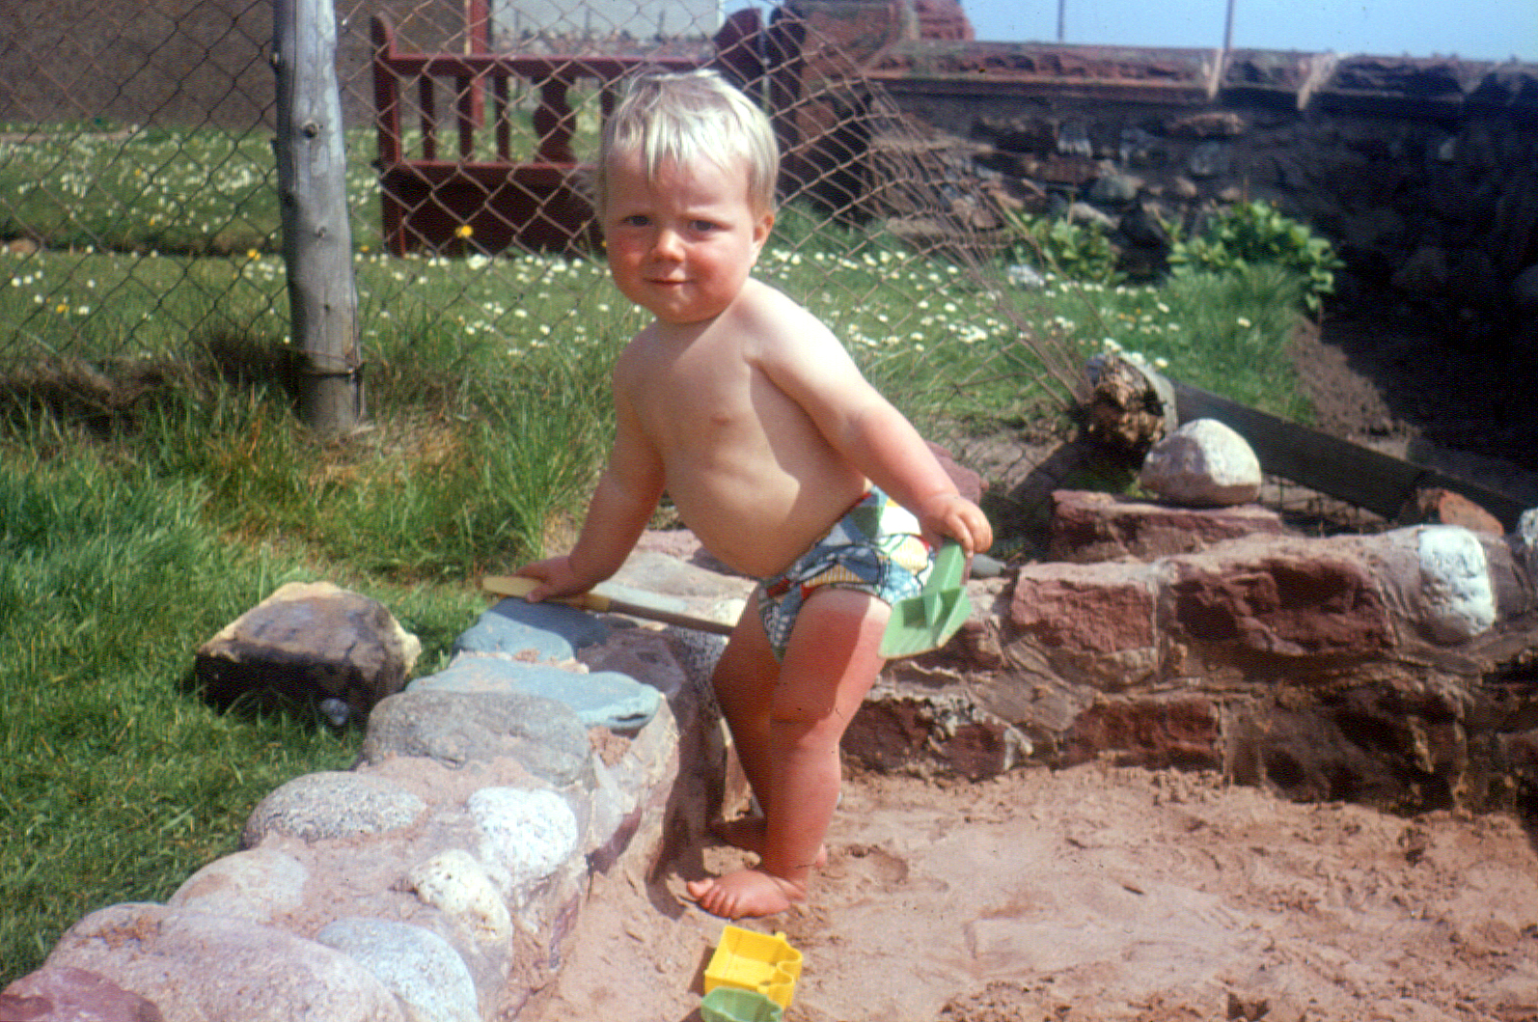
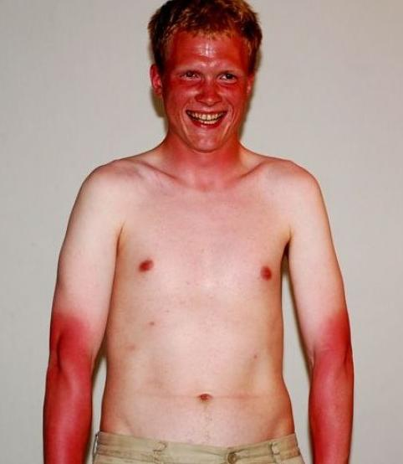
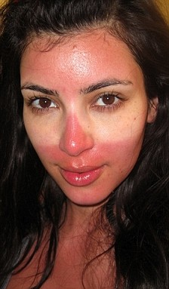
Thiopurines

Slide 44
Azathioprine
100
90
Patients (2nd course)
80
70
Controls (1st course)
60
Remission and <10 mg prednisone (%)
50
40
30
p = 0.15
20
10
0
0
2
4
6
8
10
12
Months
Patients at risk
30 26 17 13 7 4 3
30 25 20 16 8 7 5
Nachury M, et al. Gastroenterol 2003;124(Suppl 1): A-522 (abstr T1381)

Slide 45
Methotrexate
Similar to thiopurines, takes a while to work
Reasonable evidence for Crohn’s disease
Not so for UC, but worth a try
Side effects …
Potential hepatotoxicity after prolonged use, but not inevitable (Barbero-Villares et al. 2012. Scand J Gastroenterol.47(5):575-9. doi: 10.3109/00365521.2011.647412)
Lymphoma – no confirmed risk (Wolfe & Michaud 2004. Arthritis Rheum.50(6):1740-51. doi: 10.1002/art.20311)
SCC – slight increased risk (Vanni et al. 2020. ACR Open Rheumatol.2(12):697-704. doi: 10.1002/acr2.11187)

Slide 46
Clinical Trials
Always worth considering
Yes they are all placebo controlled RCT … but safety net
e.g. Ustekinumab
Currently ADHB trials recruiting for:
oral Filgotinib
IV and then SC Goselkumab (anti-IL-23)

Slide 47
Biologics
Anti-TNFs
Currently nothing else, but ever optimistic
Watch this space …

Slide 48

The Surgeon

Slide 49
In conclusion …
Primum non nocere!
There are always non-steroid options
Remember that your short steroid course just adds to everybody else’s over a lifetime
Steroids are the most toxic of all IBD medicines

Slide 50




Slide 51


Don’t just reach for the steroids …

